Slide 1
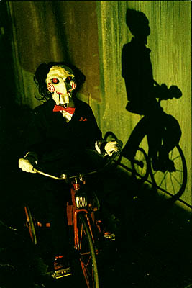
Chapter 17
Blood
“Oh yes.
There will be
blood. . .”

Slide 2
Introduction
Blood, a type of connective tissue, is a complex mixture of cells, chemicals and fluid.
- red and white blood cells
- platelets
- plasma
Blood transports substances throughout the body, and helps to maintain a stable internal environment.

Slide 3
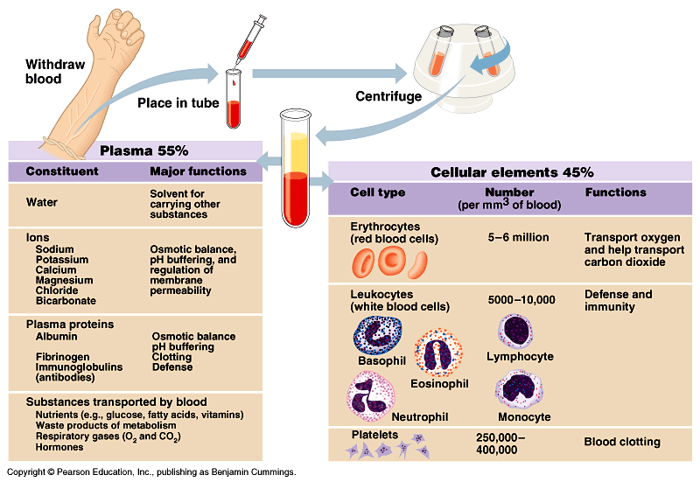
Summary of blood components

Slide 4
Physical Characteristics and Volume
Blood is a sticky, opaque fluid with a metallic taste
Color varies from scarlet to dark red
The pH of blood is 7.35–7.45
Temperature is 38°C
Blood accounts for approximately 8% of body weight
Average volume: 5–6 L for males, and 4–5 L for females

Slide 5
Functions of Blood
Blood performs a number of functions dealing with:
Substance distribution
Regulation of blood levels of particular substances
Body protection

Slide 6
Distribution
Blood transports:
Oxygen from the lungs and nutrients from the digestive tract
Metabolic wastes from cells to the lungs and kidneys for elimination
Hormones from endocrine glands to target organs

Slide 7
Regulation
Blood maintains:
Appropriate body temperature by absorbing and distributing heat
Normal pH in body tissues using buffer systems
Adequate fluid volume in the circulatory system

Slide 8
Protection
Blood prevents blood loss by:
Activating plasma proteins and platelets
Initiating clot formation when a vessel is broken
Blood prevents infection by:
Synthesizing and utilizing antibodies
Activating complement proteins
Activating WBCs to defend the body against foreign invaders

Slide 9
Blood Plasma
Blood plasma contains over 100 solutes, including:
Proteins
Albumin – maintaining osmotic/H2O balance
Globulins – antibodies for bodily defense
clotting proteins (like fibrinogen)
Lactic acid, urea, creatinine
Organic nutrients – glucose, carbohydrates, amino acids
Electrolytes – Na, K, Ca, Cl, HCO3
Respiratory gases – oxygen and carbon dioxide

Slide 10
Formed Elements
Erythrocytes, leukocytes, and platelets make up the formed elements
Only WBCs are complete cells
RBCs have no nuclei or organelles, and platelets are just cell fragments
Most formed elements survive in the bloodstream for only a few days
Most blood cells do not divide but are renewed by cells in bone marrow

Slide 11
Erythrocytes (RBCs)
Biconcave discs, anucleate, essentially no organelles
Filled with hemoglobin (Hb), a protein that functions in gas transport
Contain the plasma membrane protein spectrin and other proteins that:
Give erythrocytes their flexibility
Allow them to change shape as necessary

Slide 12
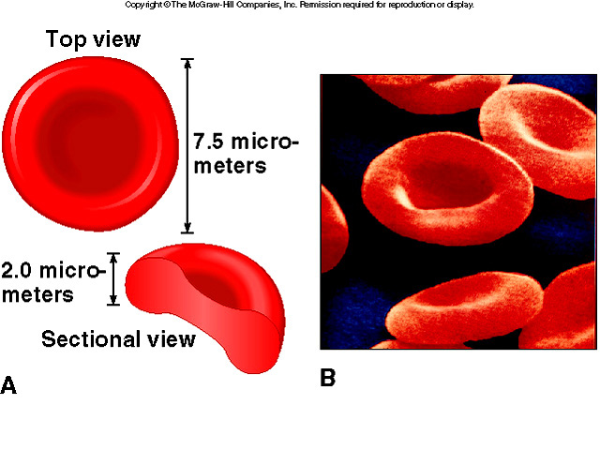
Erythrocytes (RBC)
Figure 17.3

Slide 13
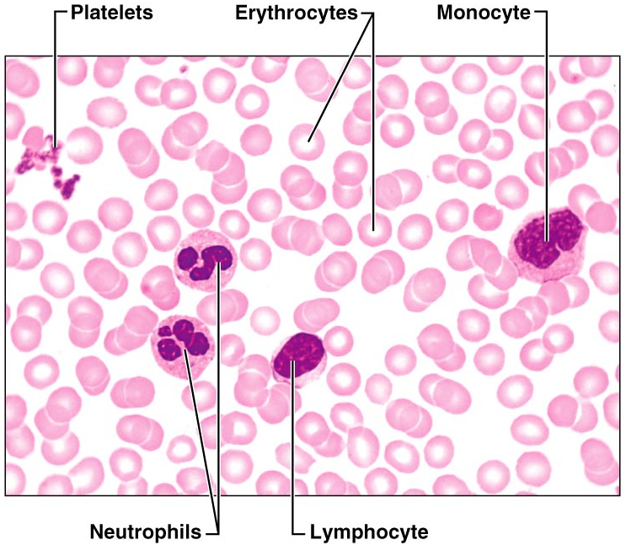
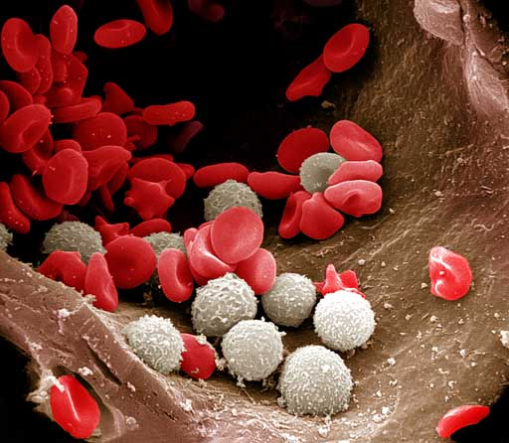
Components of Whole Blood
Figure 17.2

Slide 14
Erythrocytes (RBCs) - descriptions
Erythrocytes are an example of the complementarity of structure and function
Structural characteristics contribute to its gas transport function
Biconcave shape has a huge surface area relative to volume
Erythrocytes are more than 97% hemoglobin
ATP is generated anaerobically, so the erythrocytes do not consume the oxygen they transport

Slide 15
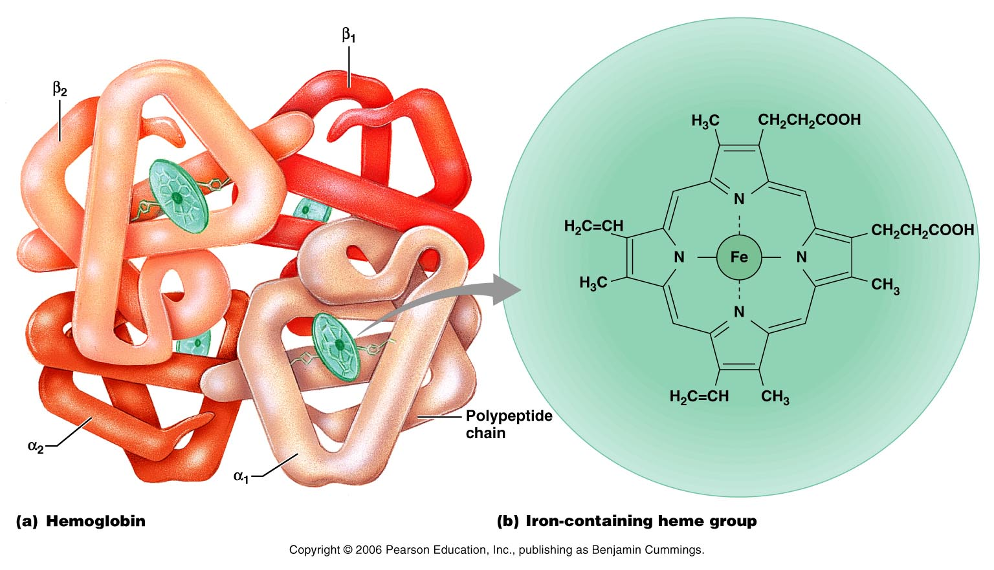
Structure of Hemoglobin
Figure 17.4

Slide 16
Hemoglobin (Hb)
Oxyhemoglobin – Hb bound to oxygen
Oxygen loading takes place in the lungs
Deoxyhemoglobin – Hb after oxygen diffuses into tissues (reduced Hb)
Carbaminohemoglobin – Hb bound to carbon dioxide
Carbon dioxide loading takes place in the tissues
PLAY
InterActive Physiology ®:
Respiratory System: Gas Transport, pages 3–13

Slide 17
Production of Erythrocytes
Hematopoiesis – blood cell formation
Hematopoiesis occurs in the red bone marrow of the:
Axial skeleton and girdles
Epiphyses of the humerus and femur
Hemocytoblasts give rise to all formed elements
Process takes about 15 days

Slide 18
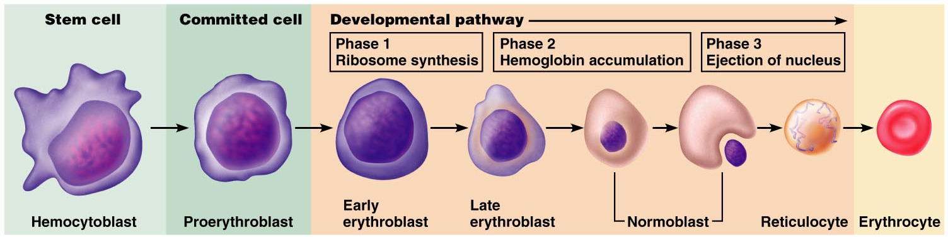
Production of Erythrocytes: Erythropoiesis
Figure 17.5

Slide 19
Regulation and Requirements for Erythropoiesis
Circulating erythrocytes – the number remains constant and reflects a balance between RBC production and destruction
Too few RBCs leads to tissue hypoxia/anemia
Too many RBCs causes undesirable blood viscosity (polycythemia)
Erythropoiesis is hormonally controlled and depends on adequate supplies of iron, amino acids, and B vitamins

Slide 20
Erythrocyte Disorders
Polycythemia
Abnormal excess of RBCs; increases blood viscosity, causing sluggish blood flow
Polycythemia vera: Bone marrow cancer leading to excess RBCs
Hematocrit may go as high as 80%
Treatment: therapeutic phlebotomy
Secondary polycythemia: caused by low O₂ levels (example: high altitude) or increased EPO production

Slide 21

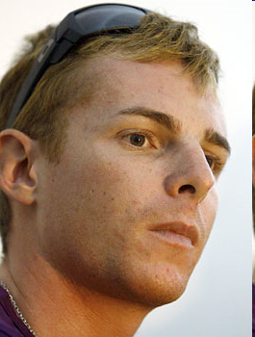
Blood Doping
Injecting previously stored RBC’s or hormones (e.g. EPO) before an athletic event
more cells available to deliver oxygen to tissues
Dangerous
increases blood viscosity
forces heart to work harder
Banned by Olympic committee
and Tour de France
Yulia Efimova
A 'mistake,' Riccardo Riccò says of doping during
Tour de France
July 30, 2008
He tested positive for CERA, or continuous erythropoietin receptor activator, an advanced version of the blood booster EPO.

Slide 22
Hormonal Control of Erythropoiesis
Erythropoietin (EPO) release by the kidneys is triggered by:
Hypoxia due to decreased RBCs
Decreased oxygen availability
Increased tissue demand for oxygen
Is enhanced by testosterone
Enhanced erythropoiesis increases the:
RBC count in circulating blood
Oxygen carrying ability of the blood

Slide 23
Fate and Destruction of Erythrocytes
The life span of an erythrocyte is 100–120 days
Old RBCs become rigid and fragile, and their Hb begins to degenerate
RBCs are slightly larger than the capillaries that they move through which produces “wear & tear”
Dying RBCs are engulfed by macrophages
Heme and globin are separated and the iron is salvaged for reuse

Slide 24
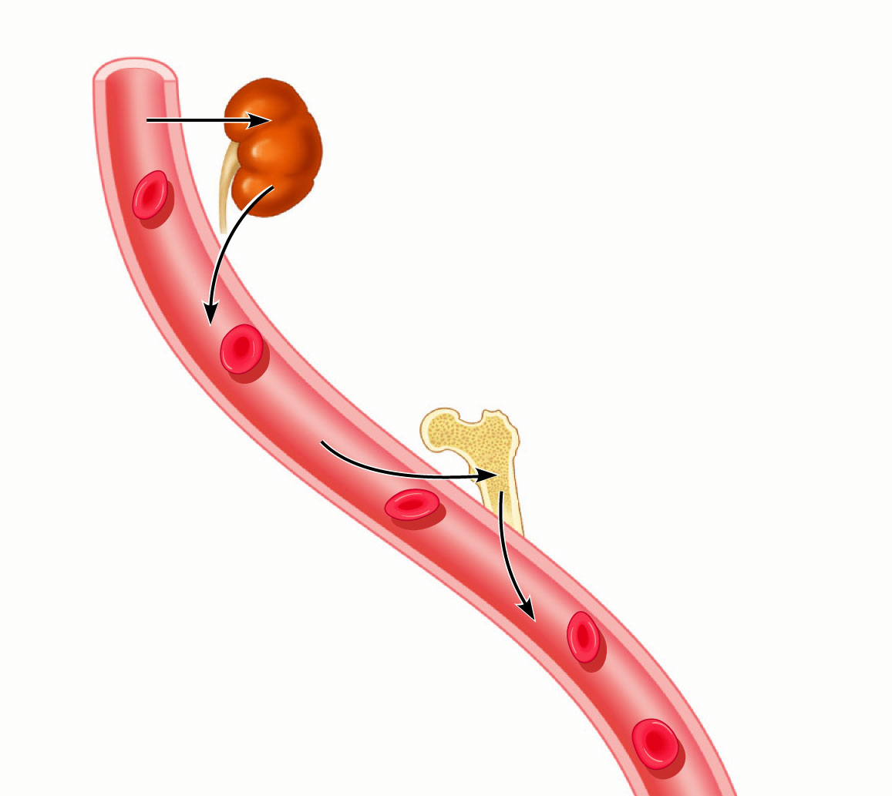
Process of erythropoiesis
1. Low O₂ levels in blood stimulate
kidneys to produce erythropoietin.
2. Erythropoietin levels
rise in blood.
3. Erythropoietin and necessary
raw materials in blood promote
erythropoiesis in red bone marrow.
4
4. New erythrocytes
enter bloodstream;
function about
120 days.
5. Aged and damaged red
blood cells are engulfed by
macrophages of liver, spleen,
and bone marrow; the hemoglobin
is broken down.

Slide 25
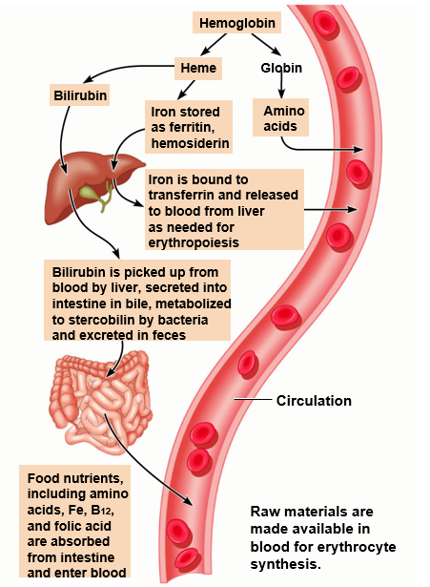
How RBC’s are removed from circulation

Slide 26
Erythrocyte Disorders - Anemia
Anemia – blood has abnormally low oxygen-carrying capacity
It is a symptom rather than a disease itself
Blood oxygen levels cannot support normal metabolism
Signs/symptoms include fatigue, paleness, shortness of breath, and chills

Slide 27
Anemia: Insufficient Erythrocytes
Hemorrhagic anemia – result of acute or chronic loss of blood
Hemolytic anemia – prematurely ruptured RBCs
Aplastic anemia – destruction or inhibition of red bone marrow

Slide 28
Anemia: Decreased Hemoglobin Content
Iron-deficiency anemia results from:
A secondary result of hemorrhagic anemia
Inadequate intake of iron-containing foods
Impaired iron absorption
Cells produced are small and pale (microcytes)
Pernicious anemia results from:
Deficiency of vitamin of intrinsic factor or dietary
B₁₂ helps in DNA synthesis and erythropoiesis
Without B12 RBCs enlarge creating macrocytes

Slide 29
Erythrocyte Disorders (cont.)
Sickle-cell anemia
Hemoglobin S: mutated hemoglobin
Only 1 amino acid is wrong in a globin beta chain of 146 amino acids
RBCs become crescent shaped when O₂ low
Example: during exercise
Misshaped RBCs rupture easily and block small vessels
Results in poor O₂ delivery and pain

Slide 30
Erythrocyte Disorders (continued)
Sickle-cell anemia (cont.)
Prevalent in black people of the African malarial belt and their descendants
Possible benefit: people with sickle cell do not contract malaria
Kills 1 million each year
Individuals with two copies of Hb-S can develop sickle-cell anemia
Individuals with only one copy have milder disease and better chance of surviving malaria

Slide 31
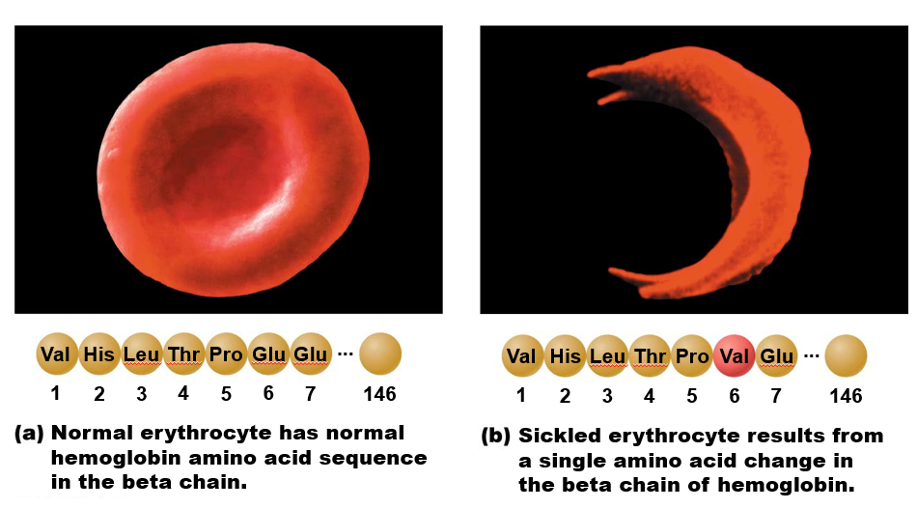
Figure 17.8 Sickle-cell anemia.

Slide 32
Leukocytes (WBCs)
Leukocytes, the only blood components that are complete cells:
Are less numerous than RBCs
Make up 1% of the total blood volume
Can leave capillaries via diapedesis
Move through tissue spaces
Leukocytosis – WBC count over 11,000 / mm³
Normal response to bacterial or viral invasion

Slide 33
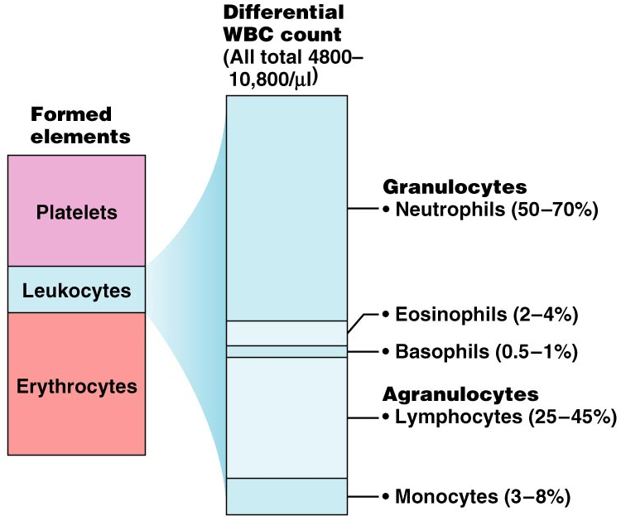
Percentages of Leukocytes

Slide 34
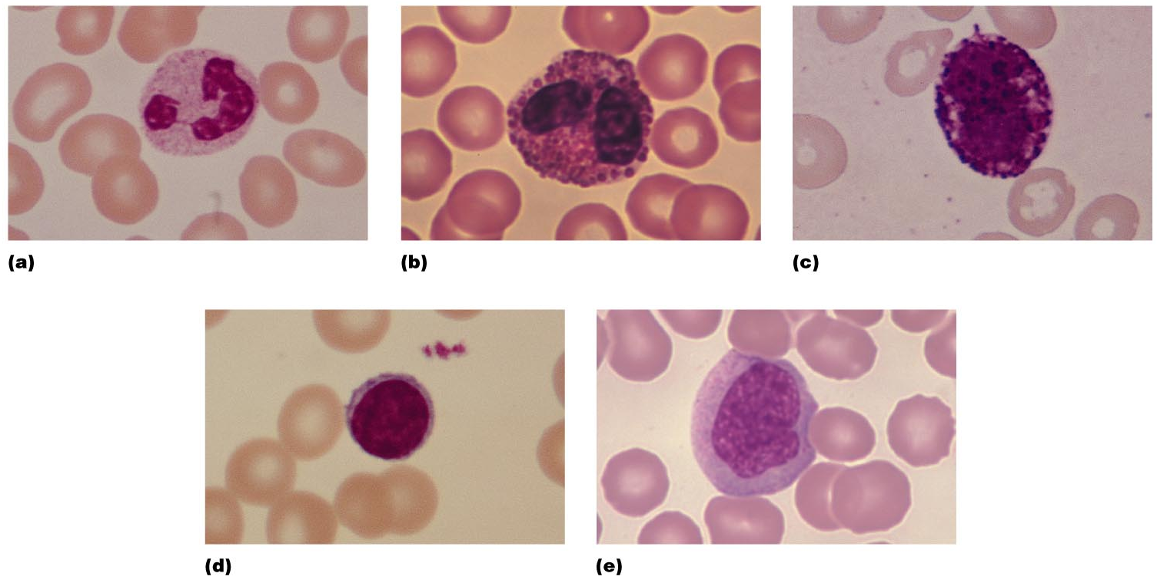
Leukocytes
Mnemonic to remember decreasing abundance in blood: Never let monkeys eat bananas

Slide 35
Granulocytes
Granulocytes – neutrophils, eosinophils, and basophils
Contain cytoplasmic granules that stain specifically (acidic, basic, or both) with Wright’s stain
Are larger and usually shorter-lived than RBCs
Have lobed nuclei
Are all phagocytic cells

Slide 36
Agranulocytes
Agranulocytes – lymphocytes and monocytes:
Lack visible cytoplasmic granules
Are similar structurally, but are functionally distinct and unrelated cell types
Have spherical (lymphocytes) or kidney-shaped (monocytes) nuclei

Slide 37
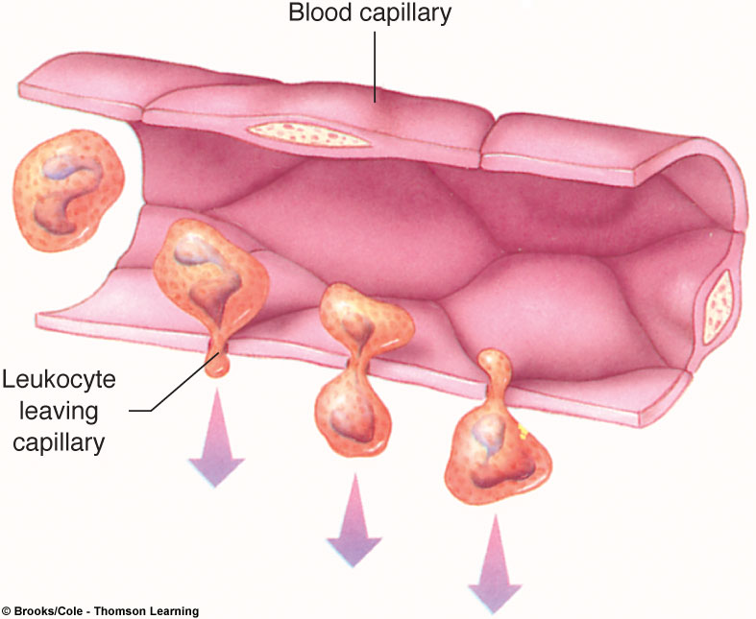
Inflammation responses are a series of events.
Neutrophils or monocytes emigrate from the blood into the area.
They adhere to the inside surface of capillaries by margination.
They enter the interstitial spaces by diapedesis and are guided by positive chemotaxis.

Slide 38
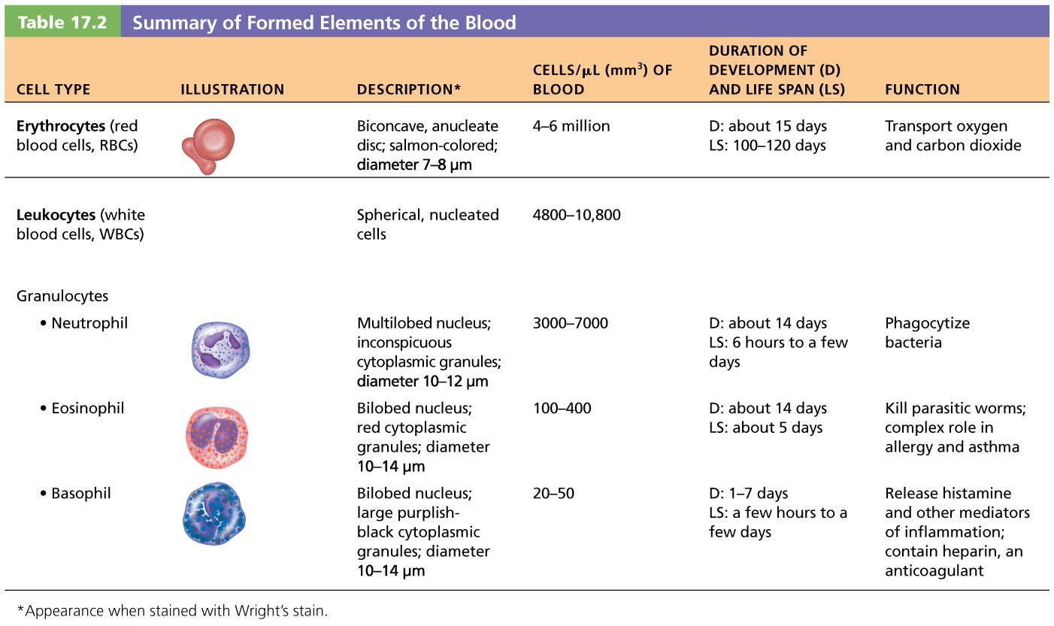
Summary of Formed Elements
Table 17.2.1

Slide 39
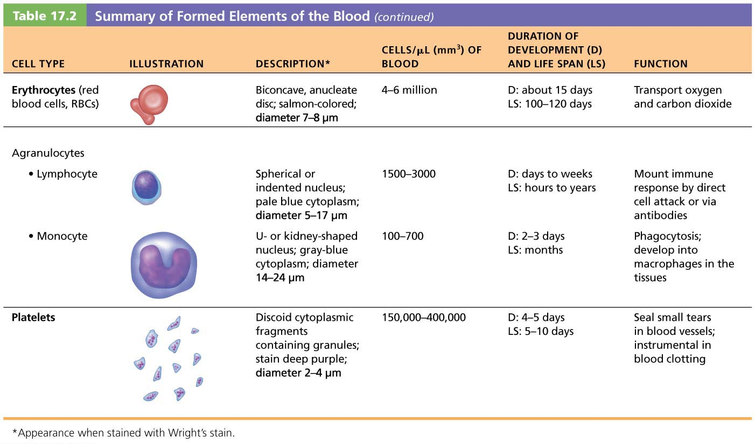
Summary of Formed Elements (continued)
Table 17.2.2

Slide 40
Production of Leukocytes
Leukopoiesis is stimulated by interleukins and colony-stimulating factors (CSFs)

Slide 41
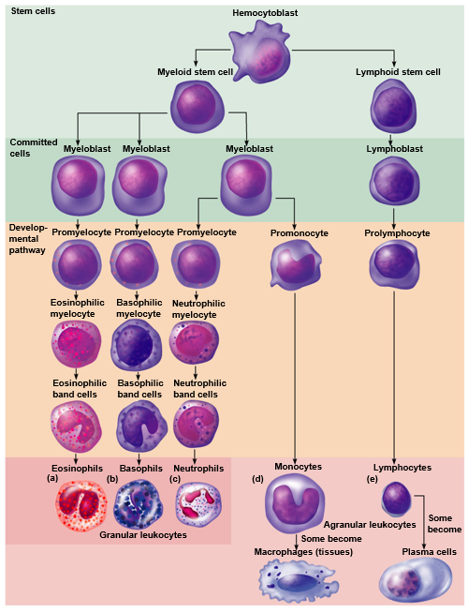
Blood cell developmental cell lines

Slide 42
Leukemia
Immature WBCs are found in the bloodstream in all leukemias
Bone marrow becomes totally occupied with cancerous leukocytes
The WBCs produced, though numerous, are not functional
Death is caused by internal hemorrhage and overwhelming infections
Treatments include irradiation, antileukemic drugs, and bone marrow transplants
Without treatment, all leukemias are fatal

Slide 43
Leukocyte Disorders (cont.)
Infectious mononucleosis
Highly contagious viral disease (“kissing disease”)
Usually seen in young adults
Caused by Epstein-Barr virus
Results in high numbers of typical agranulocytes
Involve lymphocytes that become enlarged
Originally thought cells were monocytes, so disease named mononucleosis

Slide 44
Platelets
Platelets are fragments of megakaryocytes with a blue-staining outer region and a purple granular center
Their granules contain serotonin, Ca²⁺, enzymes, ADP, and platelet-derived growth factor (PDGF)
Platelets function in the clotting mechanism by forming a temporary plug that helps seal breaks in blood vessels
Platelets not involved in clotting are kept inactive by NO and prostacyclin

Slide 45
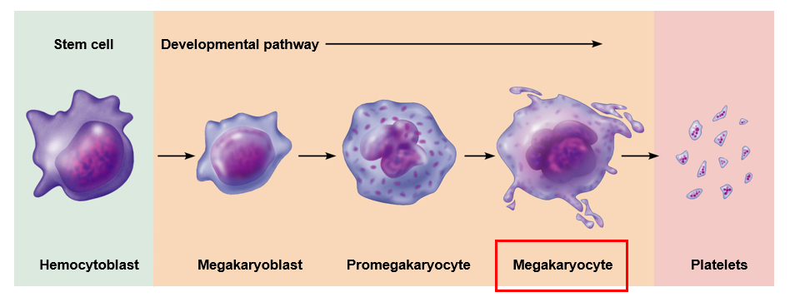
Genesis of Platelets

Slide 46
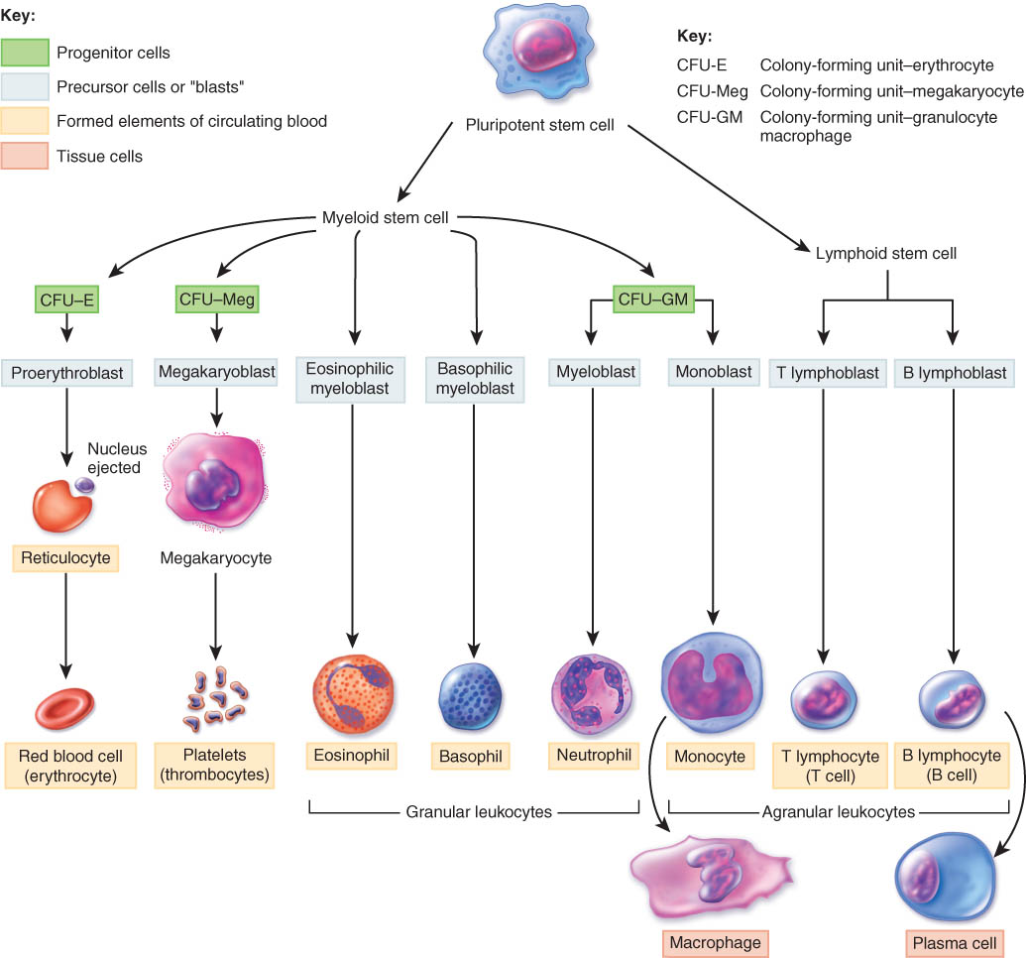
Hematopoiesis
hemocytoblast

Slide 47
Hemopoietic Growth Factors
Regulate differentiation & proliferation
Erythropoietin (EPO)
produced by the kidneys increase RBC precursors
Cytokines are local hormones of bone marrow
colony-stimulating factor (CSF) & interleukin stimulate WBC production
Thrombopoietin (TPO)
hormone from liver stimulates platelet formation

Slide 48
Hemostasis
A series of reactions for stoppage of bleeding
During hemostasis, three phases occur in rapid sequence
Vascular spasms – immediate vasoconstriction in response to injury
Platelet plug formation
Coagulation (blood clotting)

Slide 49
Platelet Plug Formation
Platelets do not stick to each other or to blood vessels
Upon damage to blood vessel endothelium platelets:
With the help of von Willebrand factor (VWF) adhere to collagen
Are stimulated by thromboxane A2
Stick to exposed collagen fibers and form a platelet plug
Release serotonin and ADP, which attract still more platelets
The platelet plug is limited to the immediate area of injury by prostacyclin

Slide 50
Coagulation
A set of reactions in which blood is transformed from a liquid to a gel
Coagulation follows intrinsic and extrinsic pathways
The final three steps of this series of reactions are:
Prothrombin activator is formed
Prothrombin is converted into thrombin
Thrombin catalyzes the joining of fibrinogen into a fibrin mesh

Slide 51
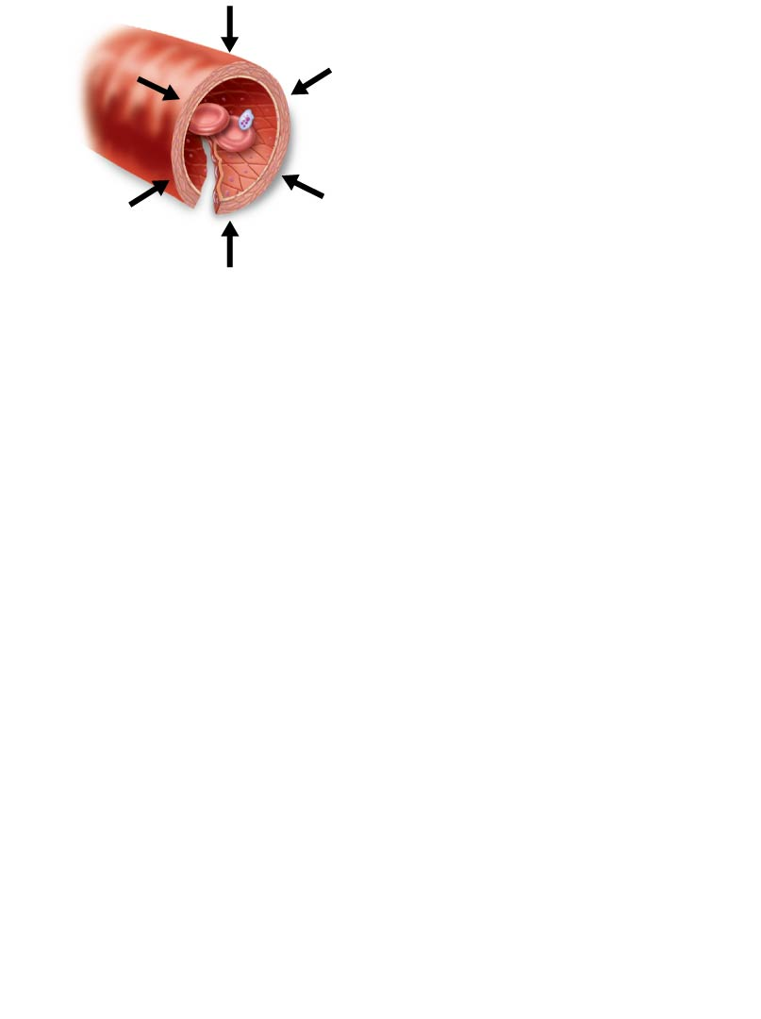
Steps of hemostasis part I
1. Vascular spasm
• Smooth muscle contracts,
causing vasoconstriction.

Slide 52
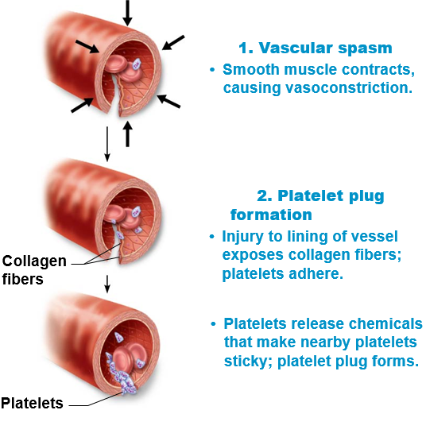
Steps of hemostasis part II

Slide 53
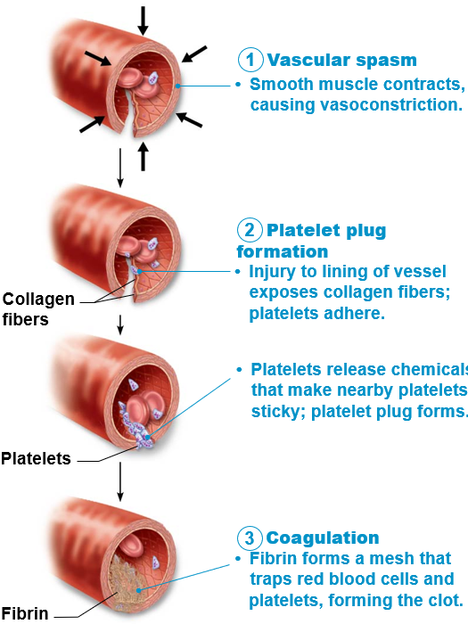
Steps of hemostasis part III

Slide 54
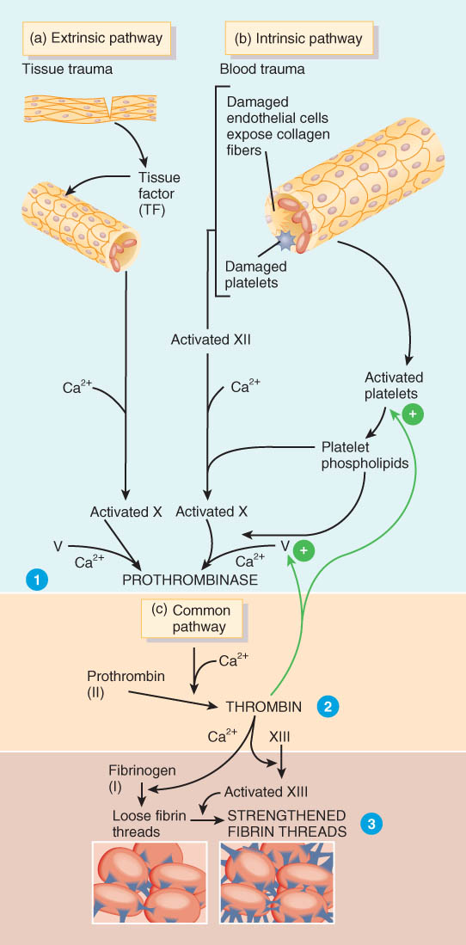
Overview of the Clotting Cascade
Prothrombinase is formed by either the intrinsic or extrinsic pathway
Final common pathway produces fibrin threads

Slide 55
The two clotting pathways
Intrinsic pathway
Called “intrinsic” because clotting factors are present within the blood
Triggered by negatively charged surfaces such as activated platelets, collagen, or even a test tube
Extrinsic pathway
Called “extrinsic” because factors needed for clotting are located outside blood
Triggered by exposure to tissue factor (TF); also called factor III
Bypasses several steps of intrinsic pathway, so faster

Slide 56
Clot Retraction and Repair
Clot retraction – stabilization of the clot by squeezing serum from the fibrin strands
Repair
Platelet-derived growth factor (PDGF) stimulates rebuilding of blood vessel wall
Fibroblasts form a connective tissue patch
Stimulated by vascular endothelial growth factor (VEGF), endothelial cells multiply and restore the endothelial lining

Slide 57
Factors Limiting Clot Growth or Formation
Two homeostatic mechanisms prevent clots from becoming large
Swift removal of clotting factors
Inhibition of activated clotting factors

Slide 58
Hemostatic Control Mechanisms
Fibrinolytic system dissolves small, inappropriate clots & clots at a site of a completed repair
fibrinolysis is dissolution of a clot
Inactive plasminogen is incorporated into the clot
activation occurs because of factor XII and thrombin
plasminogen becomes plasmin (fibrinolysin) which digests fibrin threads
Clot formation remains localized
Anticoagulants present in blood produced by mast cells

Slide 59
Hemostasis Disorders: Thromboembolytic Conditions
Thrombus – a clot that develops and persists in an unbroken blood vessel
Thrombi can block circulation, resulting in tissue death
Coronary thrombosis – thrombus in blood vessel of the heart

Slide 60
Hemostasis Disorders: Thromboembolytic Conditions (continued)
Embolus – a thrombus freely floating in the blood stream
Pulmonary emboli can impair the ability of the body to obtain oxygen
Cerebral emboli can cause strokes

Slide 61
Prevention of Undesirable Clots
Substances used to prevent undesirable clots:
Aspirin – an antiprostaglandin that inhibits thromboxane A₂
Heparin – an anticoagulant used clinically for pre- and postoperative cardiac care
Warfarin – used for those prone to atrial fibrillation

Slide 62
Hemostasis Disorders: Bleeding Disorders
Hemophilias – hereditary bleeding disorders caused by lack of clotting factors
Hemophilia A – most common type (83% of all cases) due to a deficiency of factor VIII
Hemophilia B – due to a deficiency of factor IX
Hemophilia C – mild type, due to a deficiency of factor XI

Slide 63
Transfusing Red Blood Cells
Whole-blood transfusions are used only when blood loss is rapid and substantial
Infusions of packed red blood cells, or PRBCs (plasma and WBCs removed), are preferred to restore oxygen-carrying capacity
Blood banks usually separate donated blood into components; shelf life of blood is about 35 days
Human blood groups of donated blood must be determined because transfusion reactions can be fatal
Blood typing determines groups

Slide 64
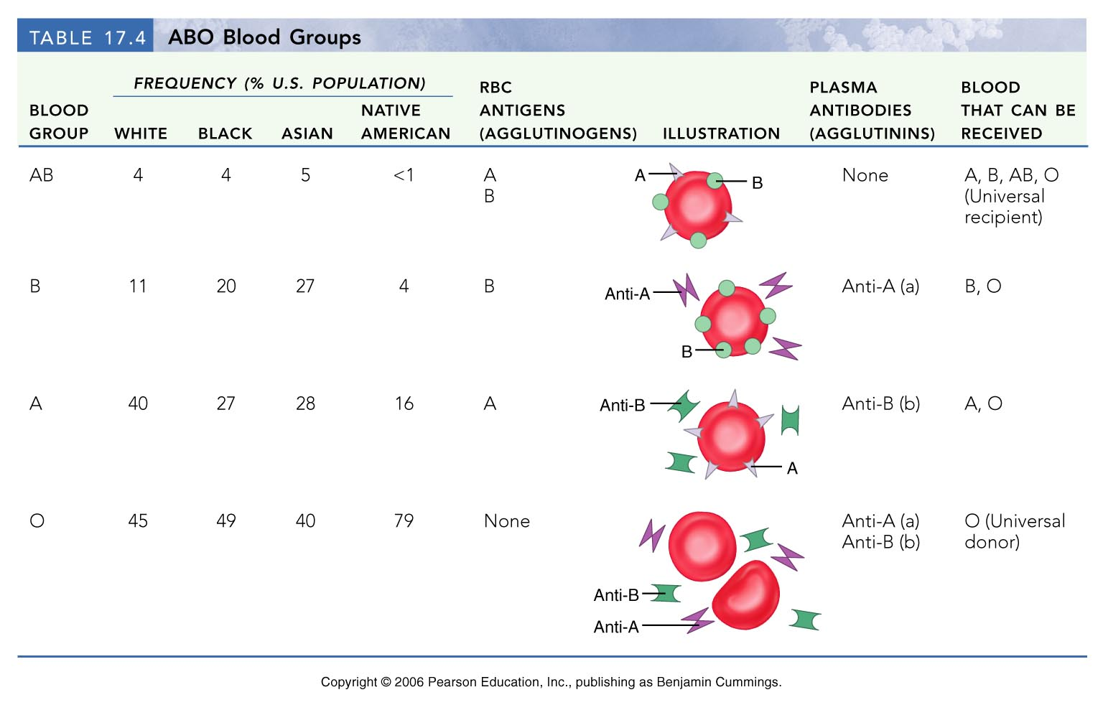
ABO Blood Groups
Table 17.4

Slide 65
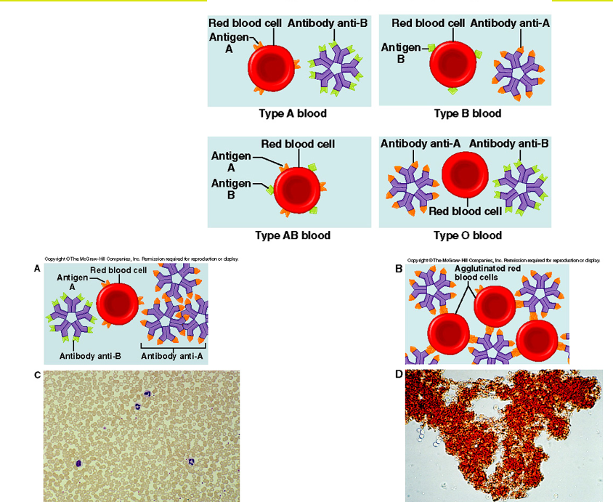
Agglutination

Slide 66
Rh Blood Groups
There are eight different Rh agglutinogens, three of which (C, D, and E) are common
Presence of the Rh agglutinogens on RBCs is indicated as Rh⁺
Anti-Rh antibodies are not spontaneously formed in Rh– individuals
However, if an Rh– individual receives Rh⁺ blood, anti-Rh antibodies form
Named for the rhesus monkey where they were originally discovered

Slide 67
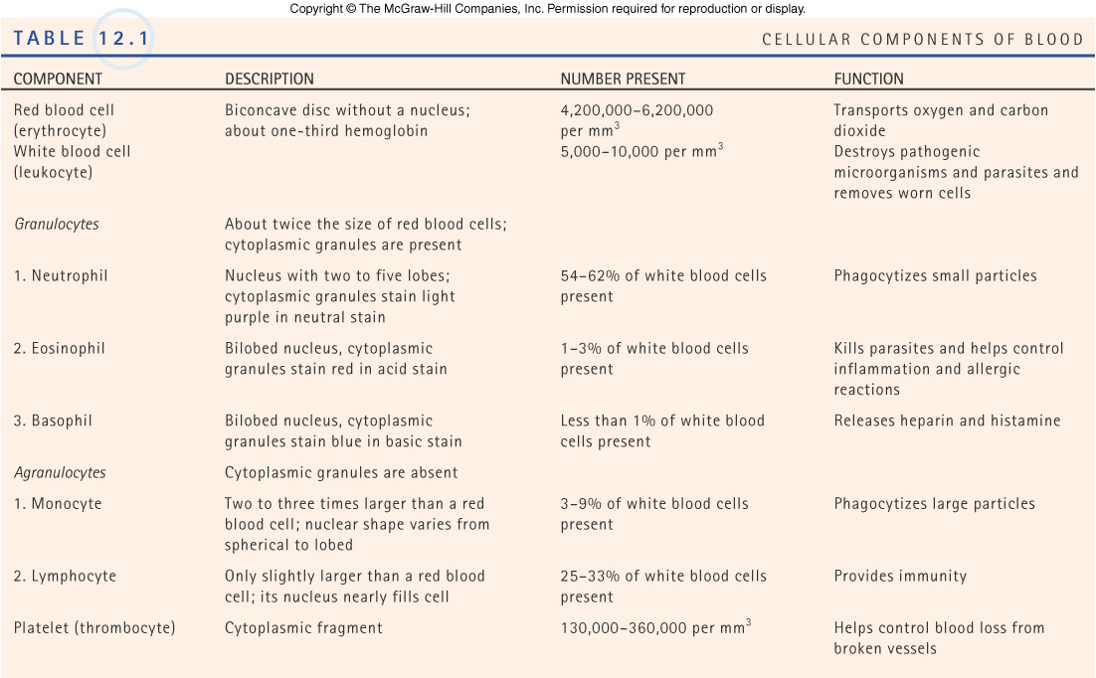
Formed elements of the blood
Copyright©The McGraw-Hill Companies, Inc. Permission required for reproduction or display.

Slide 68
Developmental Aspects
Before birth, blood cell formation takes place in the fetal yolk sac, liver, and spleen
By the seventh month, red bone marrow is the primary hematopoietic area
Blood cells develop from mesenchymal cells called blood islands
The fetus forms HbF, which has a higher affinity for oxygen than adult hemoglobin

